Slide 1
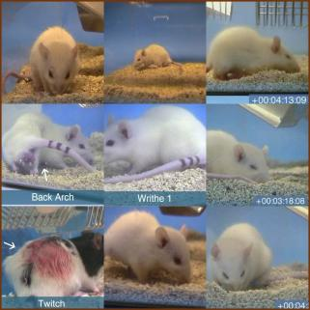
A framework for presenting several modules on the topics of
Pain and Distress and Humane Endpoints in the Laboratory Animal Facility
courtesy of Prof. Paul Flecknell
Version 6 October 2016

Slide 2
Pain and Distress and Humane Endpoints in the Laboratory Animal Facility
These training modules were designed by Group A of the August 2016 cohort convened by PRIM&R during the ICARE Train-the-Trainer Institute. The premise was to learn active learning techniques and apply them to facets of laboratory animal program management and the care and use of laboratory animals. The assignment for Group A was “pain and distress (P&D) and humane endpoints (HE)”.
We - Bruce W. Kennedy, Kelly Fusco, Gene Hines, Tanise Jackson, and Trina Smith – wish you success as you incorporate our ideas into your own institutional training program regarding this important subject. Feel free to adapt as you see fit to suit your audience, time frames, and institutional needs.
While it is Group A that designed and contributed this material, we are grateful for the training and guidance we received during the workshop.
courtesy of Prof. Paul Flecknell

Slide 3
Pain and Distress and Humane Endpoints teaching framework - introduction
The concepts of active learning are based on observations and research showing that students who have the ability to monitor their own learning learn better. Such concepts are meant to get away from the traditional lecture means of teaching.
Designing the curriculum this way includes several steps: defining goals and objectives, devising assessments, and creating activities or tasks (the acronym GOATs helps to remember this). The assessments are composed of formative (along the way, such as in class) and summative (final, such as a test) evaluations of knowledge or technique. There are examples provided here, but trainers should feel free to design their own material for their unique institutional needs.
Four goals were created (two having two sub-goals). Curriculum for goals 3a and 3b was more extensively developed, but there are tasks and assessments for all as shown in the teaching framework chart slides.
In the notes section of many of the slides, there are descriptions to suggest how to use the material presented for the particular GOAT.

Slide 4
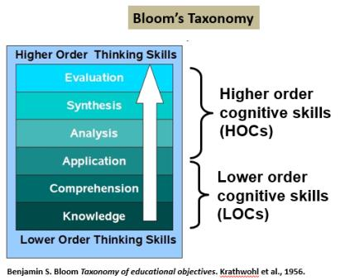
Pain and Distress and Humane Endpoints teaching framework – Bloom’s
The chart at left presents the structure of Bloom’s taxonomy, which was developed by educators as a model of the way we learn. At the bottom is the foundation of cognition or the ways by which we acquire knowledge. These are considered LOCs for lower order cognition. Once received, the ability to use the knowledge at higher levels (HOCs) becomes apparent.
In a table that follows, there is a summary of many cognitive skills for P&D and HE in a teaching framework. For each learning module’s objectives, we include LOCs, like learning vocabulary related to P&D and HE, and HOCs, where evaluation of animals in research and appropriate actions are taken, can be taught. Note, too, that “application” of an objective can be a blend of LOC and HOC.

Slide 5


Pain and Distress and Humane Endpoints
Who are the students, that is, the intended audience: primarily, operations staff (i.e., veterinary, husbandry, and research); also the IACUC (protocol reviewers)
When, the anticipated amount of time to devote to each module: 45 to 60 minutes
Note: Designing a training session can utilize the concept of the 6 Ws tool, that is, defining who, when, where, what, how, and why. (Tools for organizing training, part 1, Lab Animal 45, 269 (2016))

Slide 6
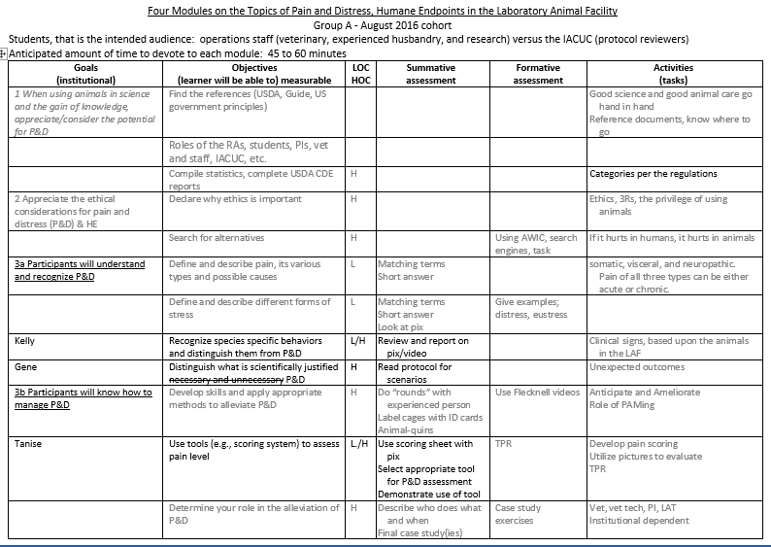

Pain and Distress and Humane Endpoints teaching framework chart - GOATs
Page 1

Slide 7
Pain and Distress and Humane Endpoints teaching framework chart - GOATs
Page 2

Slide 8
Pain and Distress and Humane Endpoints teaching framework chart - GOATs
Goals (both general and institutional) | Objectives - learner will be able to … - measurable items through assessment | LOC² HOC | Summative assessment | Formative assessment (rubrics) | Possible Activities, Tasks, Exercises, and Assignments aligned with Active Learning
 | State and define the 3Rs as they relate to P&D and HE. | L | Match the 3R terms with various approaches of P&D. Role play a 3Rs “conversation” between PI and IAUC members discussing a protocol during a review. | Correctly define the 3Rs. | Analyze protocol applications from several institutions to learn how they obligate the research team to relate ethics with potential P&D and HE.
 | Be knowledgeable of the effect that enrichment can have on addressing P&D. | L | Describe to others the enrichment value of a tool for a particular species. | Complete an assessment to match enrichment items with particular types of animals. | Using either pictures or actual items, discuss how they can be tools of enrichment. Build a “Jeopardy” type game.
 | Remain appraised of current relevant literature. | l/H | Read and report on literature about P&D and HE by parceling sections and reporting together (jigsaw). | Name several journals that report on the studies of P&D in laboratory animal science. | See suggested papers: - Guidelines for the ethical use of animals in applied ethology studies (2002) - Guidelines for the treatment of animals in behavioral research and teaching (2012)
 | Declare why ethics is important. | H | Create a map of the structure of an article (e.g., J. Tannenbaum “Ethics and Pain Research in Animals” ILAR Journal 40 (3): 97-110) related to ethical issues. | Define terms such as ethics, the 3Rs, the privilege of using animals, etc. | Compare and contrast biomedical advocates and animal rights groups’ positions on the usage of animals in P&D studies.
 | Search for alternatives. | H | Watch and discuss “impacts” (https://www.nc3rs.org.uk/our-impacts). | Using resources at AWIC, apply search engines with key words. | Utilize training materials from AWIC to conduct searches.
 | Learn how P&D can affect and impact scientific results. | H | Diagram an animal body for sites where P&D could manifest. | Select a publication and summarize how the authors predicted P&D | Consider the statement “If it hurts in humans, it hurts in animals” and decide what organs/tissues would respond.
Page 3

Slide 9
Pain and Distress and Humane Endpoints teaching framework chart - GOATs
Goals (both general and institutional) | Objectives - learner will be able to … - measurable items through assessment | LOC² HOC | Summative assessment | Formative assessment (rubrics) | Possible Activities, Tasks, Exercises, and Assignments aligned with Active Learning
 | Decide when P&D could be acceptable. Stated otherwise, why care about it? | H | Compare and contrast three criteria: 1) are the animals fit for purpose (integrity)?, 2) what amount of P&D (suffering) is acceptable?, and 3) how does imposing P&D relate to living (telos)? | Respond to a protocol scenario of P&D. | Create research questions which require a degree of P&D in order to answer (e.g., migraines).
 | Analyze “mission creep” in using the USDA C/D/E scale for non-covered species. | H | Debate whether it is mission creep. Find examples from institutions which state (?websites, SOPs, protocols) that they apply the categories to non-USDA animals. | Declare what is creep and what is not. Know and cite the regulations. | Evaluate scenarios and case studies about the pain categories.
3a) Participants will understand and recognize P&D. | Define and describe pain, its various types and possible causes | L | Matching terms Short answer |  | somatic, visceral, and neuropathic. Pain of all three types can be either acute or chronic.
 | Define and describe different forms of stress | L | Matching terms Short answer Look at pix | Give examples; distress, eustress
 | Recognize species specific behaviors and distinguish them from P&D | L/H | Review and report on pix/video |  | Clinical signs, based upon the animals in the LAF
 | Distinguish what is scientifically justified P&D | H | Read protocol for scenarios |  | Unexpected outcomes 85 PHS policy
3b) Participants will know how to manage P&D. | Develop skills and apply appropriate methods to alleviate P&D. | H | Do “rounds” with experienced person Label cages with ID cards Animal-quins | Use Flecknell videos | Anticipate and Ameliorate Role of PAMing
 | Use tools (e.g., scoring system) to assess pain level. | L./H | Use scoring sheet with pix Select appropriate tool for P&D assessment Demonstrate use of tool | TPR | Develop pain scoring Utilize pictures to evaluate TPR
 | Determine your role in the alleviation of P&D. | H | Describe who does what and when Final case study(ies) | Case study exercises | Vet, vet tech, PI, LAT Institutional dependent
 | Document an incident of P&D | L/H | Complete a form with no omissions |  | Alleviation
Page 4

Slide 10
Pain and Distress and Humane Endpoints teaching framework chart - GOATs
Goals (both general and institutional) | Objectives - learner will be able to … - measurable items through assessment | LOC² HOC | Summative assessment | Formative assessment (rubrics) | Possible Activities, Tasks, Exercises, and Assignments aligned with Active Learning
 | Identify whom to report an incident of P&D | H | Describe the routing process
4a) Participants will understand and recognize humane endpoints (HE). | Define terms such as humane, endpoint, interventions, humane endpoints; compare to experimental endpoints. | L | Use exercises that explore, illustrate, and define humane and experimental endpoints. | Write a short answer essay that utilizes the terms. | Find definitions and usage in the ILAR Guide, dictionary, and websites. Produce a word cloud from phrases submitted by students (http://www.wordle.net/)
 | Recite (paraphrase) the three US government principles pertaining to HE. | L | Declare what the three principles are. | Define what the three principles are meant to address in terms of HE. | U.S. Government Principles IV, V and VI are the fundamental principles pertaining to humane treatment and endpoints for animals used in research. Using charts, write each one and lead a discussion of interpretation.
 | Describe what endpoint means and what it can be (how it manifests) in the context of animal research. | L/H | In a group, each individual extracts from the abstract of a published paper where the endpoints have been described. | Defend and critique endpoints as commonly established (e.g., LD50 studies). | Use exercises that explore, illustrate, and define humane and experimental endpoints.
 | Examine policies and guidelines about HE from various research institutions. | L/H | Find HE guidelines from another institution. Compare the criteria. | Envision a study from your own institution and how the IACUC would review it. | Find the HE guidelines in your own institution. Read and discuss.
 | Evaluate the role you can play in addressing HE. | L/H | Read protocols for how HE was described. Discuss and debate with others. | Devise “task” statements to include in a position description for someone engaged in PAM (post-approval monitoring) related to HE. | Role play as vet, vet tech, PI, IACUC member, etc.
4b) Participants will learn to manage HE. | Develop skills and tactics to identify and recognize HE from a study protocol. | L/H | Find the “buzzwords” in several published papers, such as toxicology and pain disciplines. | List the “buzzwords” you should look for in a protocol related to HE. | Invite an IACUC member to class to discuss an actual occurrence.
Page 5

Slide 11
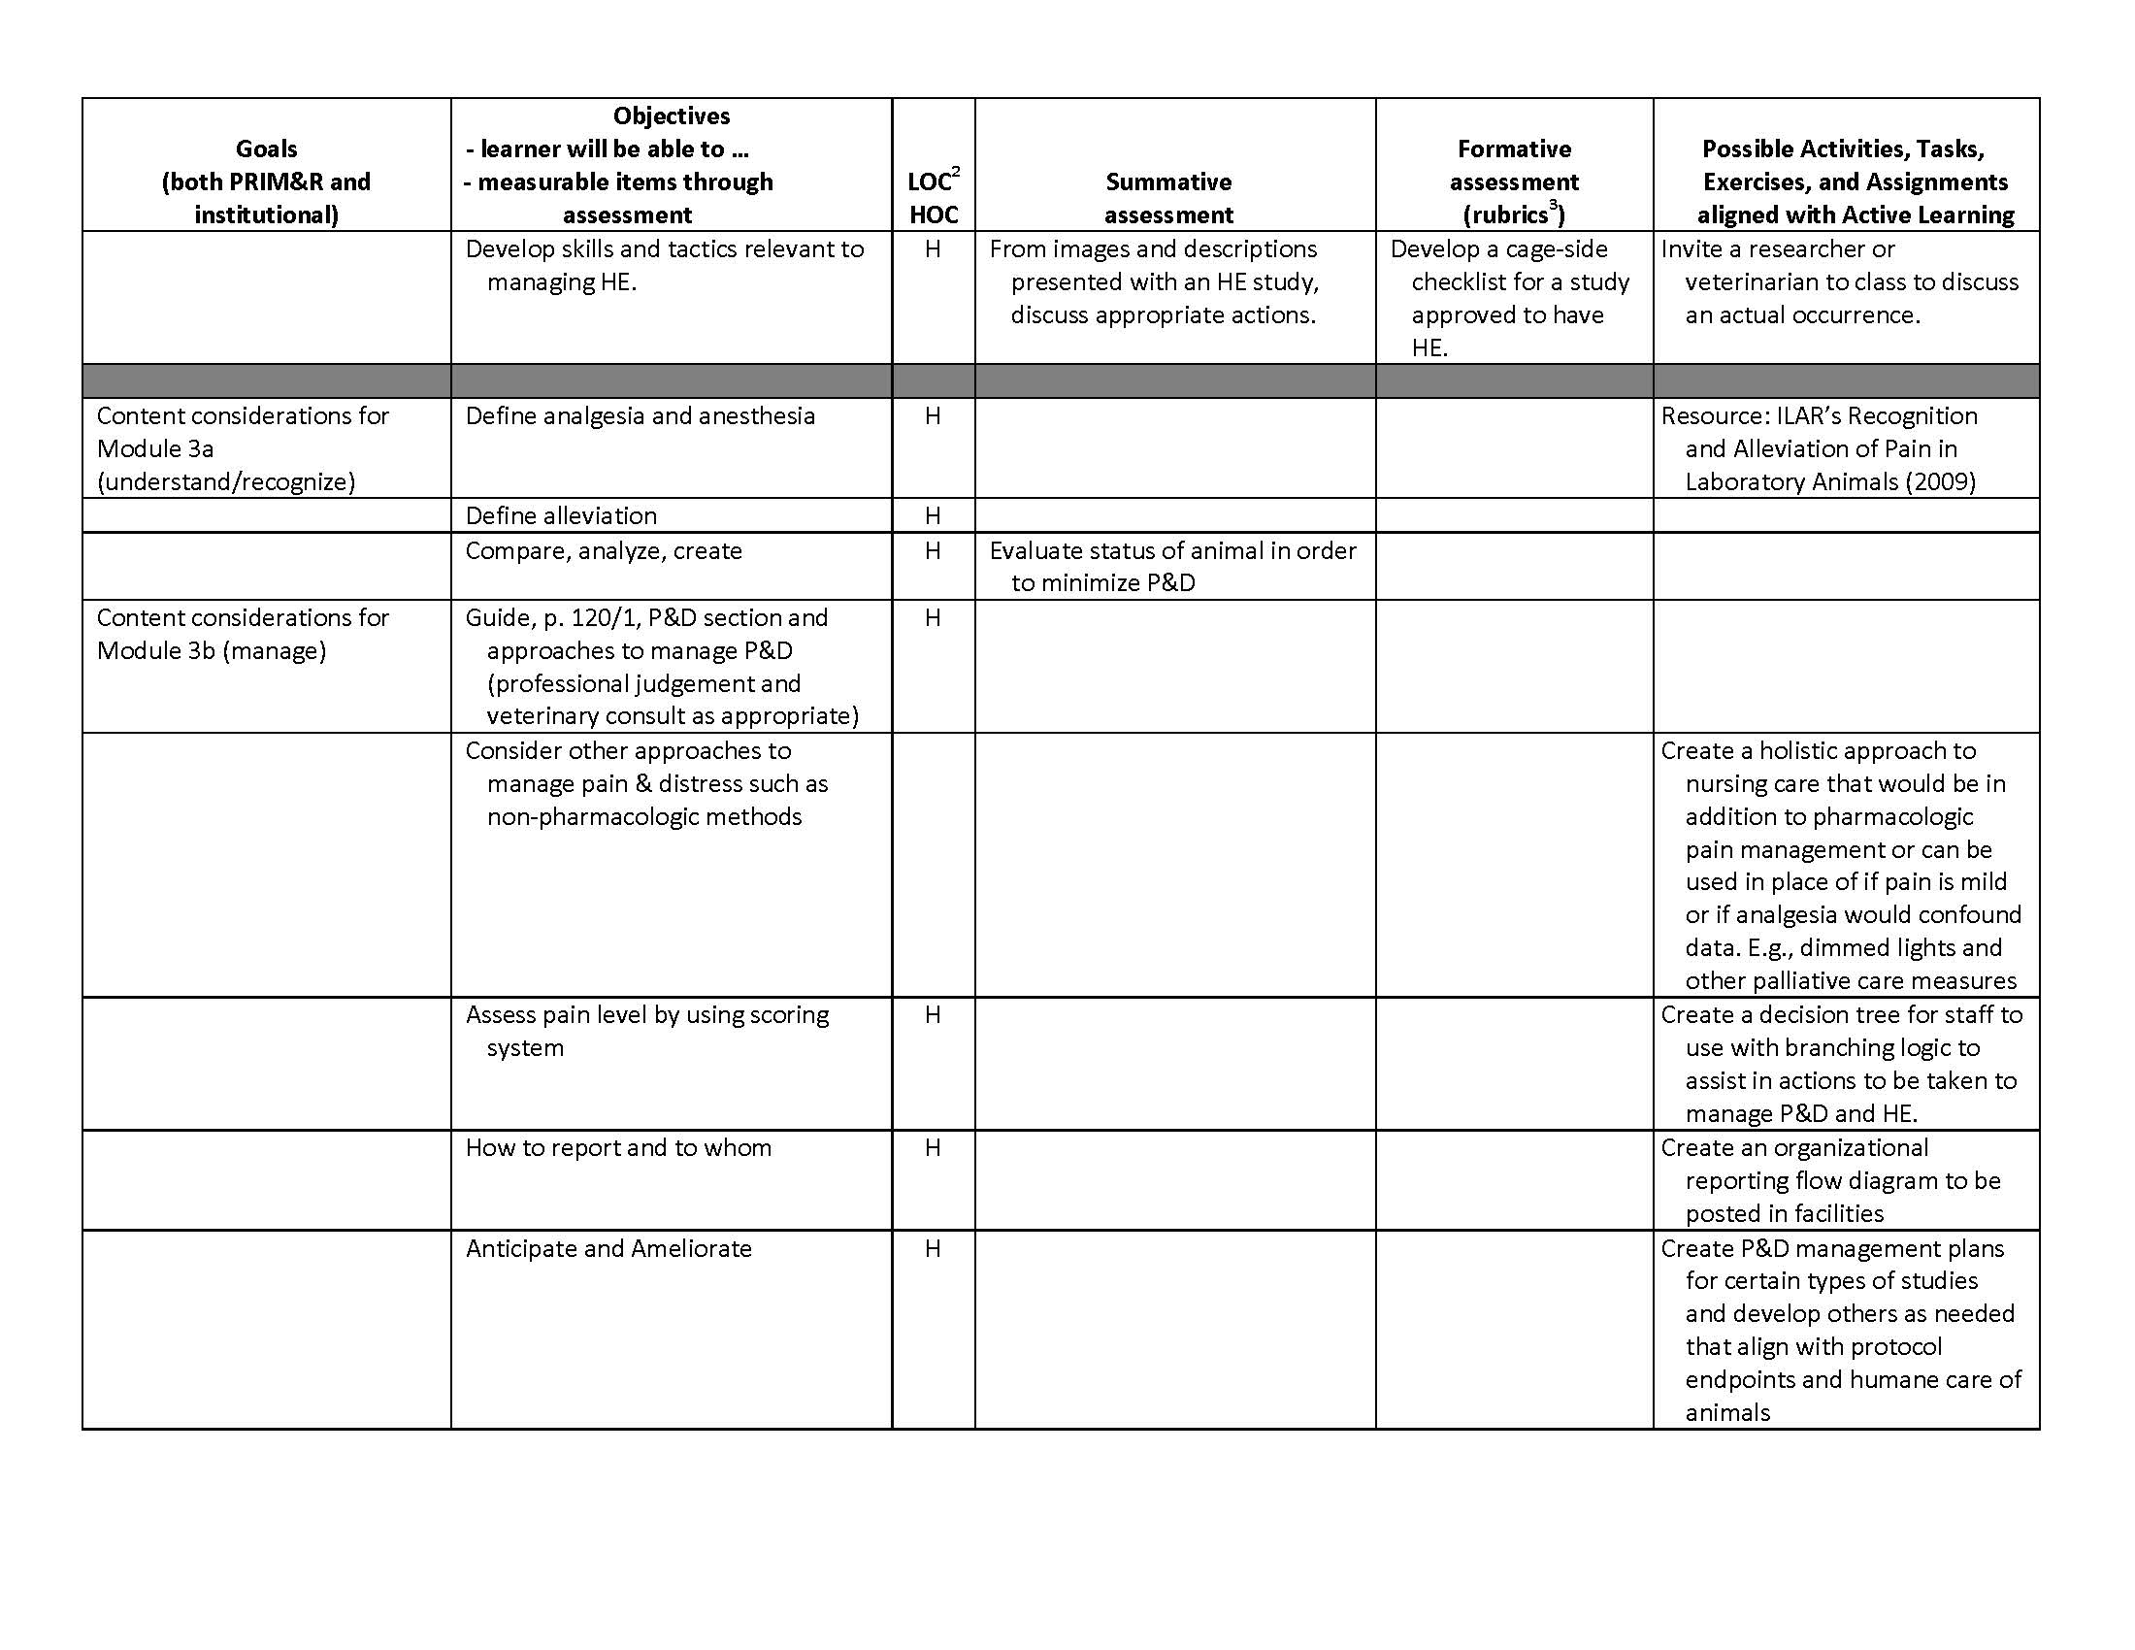
Pain and Distress and Humane Endpoints teaching framework chart - GOATs
Page 6

Slide 12
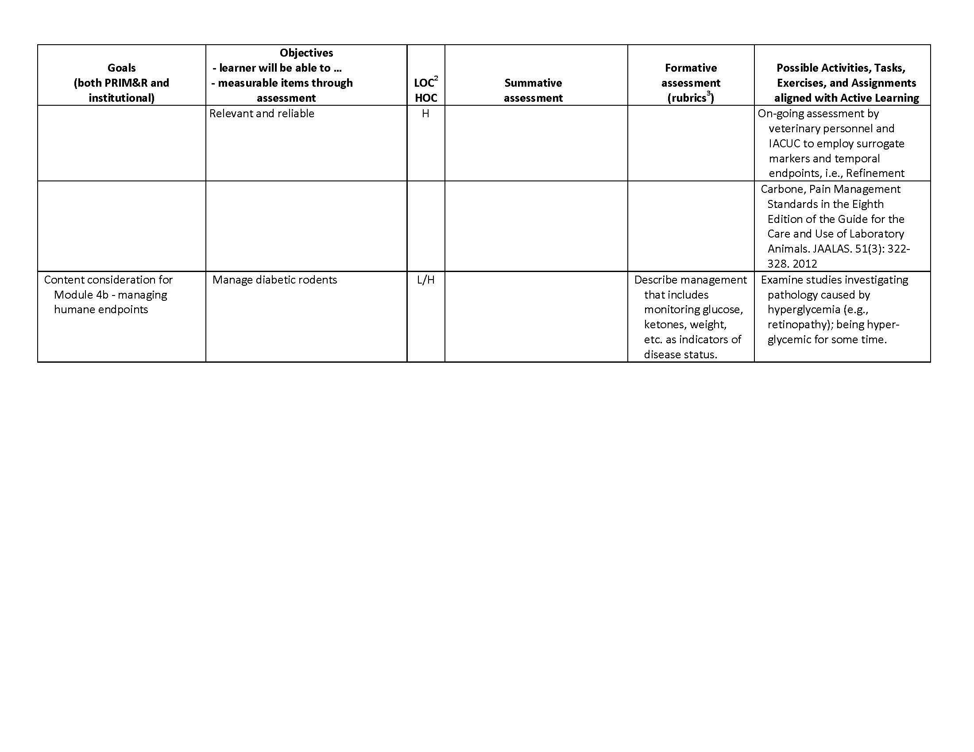
Pain and Distress and Humane Endpoints teaching framework chart - GOATs
Page 7

Slide 13

Pain and Distress and Humane Endpoints
These are the four basic goals.
When using animals in science and for the gain of knowledge, individuals must be aware to appreciate and consider the potential for pain and distress (P&D) in research investigations .
Individuals must appreciate various positions by experiencing several ethical considerations about P&D and HE.
3a Participants will understand and recognize P&D.
3b Participants will know how to manage P&D
4a Participants will understand and recognize concepts of humane endpoints (HE).
4b Participants will learn to manage HE.

Slide 14

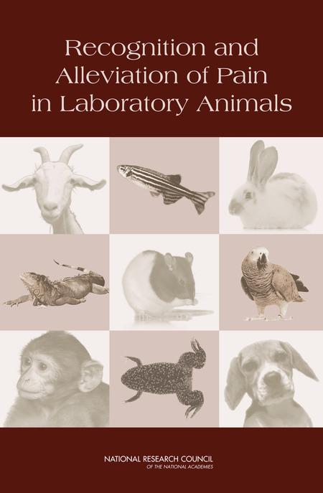
Goal 1
When using animals in science and for the gain of knowledge, individuals must be aware to appreciate and consider the potential for pain and distress (P&D) in research investigations.
Find appropriate reference materials related to P&D issues and discussions. (LOC)
Recite (paraphrase) the three US government principles pertaining to P&D. (LOC)
Recite several criteria that should/must be met for an experiment to be acceptable (approved for conduct) in a particular context. (LOC)
Be familiar with the terms “humane care and treatment” and treating animals “humanely”. (LOC)
[continued]

Slide 15
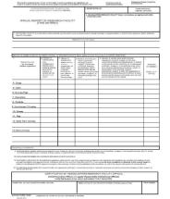
Goal 1
When using animals in science and for the gain of knowledge, individuals must be aware to appreciate and consider the potential for pain and distress (P&D) in research investigations.
[continued]
Understand and clarify the potential roles of the research assistants, students, investigators, vets and staff, IACUC members, members of the public, etc., in addressing P&D. (LOC/HOC)
Compile statistics and complete USDA category B/C/D/E reports (form 7023). (HOC)
Define and reword the phrase “Good science and good animal care go hand in hand”. (HOC)
USDA Form 7023

Slide 16
Goal 2
Individuals must appreciate various positions by experiencing several ethical considerations about P&D and HE.
Learn what factors can impact P&D. (LOC)
Recite the ILAR Guide statement “In general, unless the contrary is known or established, it should be assumed that procedures that cause pain in humans also cause pain in animals". (LOC)
State and define the 3Rs as they relate to P&D and HE. (LOC)
Be knowledgeable of the effect that enrichment can have on addressing P&D. (LOC)
[continued]
3Rs
Reduce
Replace
Refine

Slide 17

Goal 2
Individuals must appreciate various positions by experiencing several ethical considerations about P&D and HE.
[continued]
Remain appraised of current relevant literature. (LOC/HOC)
Declare why ethics is important. (HOC)
Search for alternatives. (HOC)
Learn how P&D can affect and impact scientific results. (HOC)
Decide when P&D could be acceptable. Stated otherwise, why care about it? (HOC)
Analyze “mission creep” in using the USDA C/D/E scale for non-covered species. (HOC)

Slide 18
Goal 2
Individuals must appreciate various positions by experiencing several ethical considerations about P&D and HE.
Possible support items:
“Category E: Perspectives on Unalleviated Pain and Distress" by Larry Carbone, DVM, MA, PhD, DACLAM, DACAW, an AALAS webinar presented September 27, 2016, available at https://www.aalas.org/store/meeting?productId=7021919. “This webinar will focus on how an IACUC can evaluate Category E study protocols, including whether anesthetics and analgesics will affect data and how untreated pain and distress might also affect data. We will discuss how IACUCs can evaluate the ethical justification for approving a Category E study, especially when it is not certain how pain and pain medications may affect research outcomes.“
Carbone L, Austin J (2016) Pain and Laboratory Animals: Publication Practices for Better Data Reproducibility and Better Animal Welfare. PLoS ONE 11(5): e0155001. doi:10.1371/journal.pone.0155001
Sherwin, Chris M., Stine B. Christiansen, Ian J. Duncan, Hans W. Erhard, Don C. Lay, Joy A. Mench, Cheryl E. O’Connor, and J. Carol Petherick. "Guidelines for the ethical use of animals in applied ethology studies." Applied Animal Behaviour Science 81, no. 3 (2003): 291-305. http://dx.doi.org/10.1016/S0168-1591(02)00288-5
Anonymous. “Guidelines for the treatment of animals in behavioural research and teaching.” Animal Behaviour 83, no. 1 (2012): 301–309. http://dx.doi.org/10.1016/j.anbehav.2011.10.031

Slide 19

Goal 2
Individuals must appreciate various positions by experiencing several ethical considerations about P&D and HE.
Conditions of housing
(T, %RH, light, airflow, etc.)
Exercise to enter factors that could potentially affect pain and distress. Complete the wheel (start with it blank).
Social or single housing
Enrichment
Pain and distress
Health type (sick, infected)
???
???
Territory
Dominance

Slide 20
Goal 3a
Understanding and recognizing P&D
Define and describe pain, its various types and possible causes. (LOC)
Define and describe different forms of stress. (LOC)
Recognize species specific behaviors and distinguish them from P&D. (LOC/HOC)
Distinguish what is scientifically justified P&D, consistent with sound research design. (HOC)

Slide 21
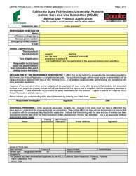
Goal 3a: Understanding and recognizing P&D
Objective: Distinguish what is scientifically justified P&D
Summative assessments: Role play, read protocol
for scenarios, and report

Slide 22
Goal 3a
Understanding and recognizing P&D
Define and describe pain, its various types and possible causes.
Pain is an unpleasant sensory and emotional experience associated with actual or potential tissue damage that typically involves a noxious stimulus that activates nociceptors in the body’s tissues that convey signals to the central nervous system (Pain¹, p. 13).
Momentary/Slight Pain refers to pain that is momentary, such as associated with a needle stick (e.g., drug injection, venipuncture) or an experimentally applied noxious stimulus that does not produce noticeable tissue damage (e.g., pinch, mild and brief electric shock). Momentary pain may generate a withdrawal reflex or vocalization, however, this pain is of very short duration (seconds to tens of seconds, or perhaps minutes when assessing pain tolerance) and consequences to the subject are minimal and brief (Pain¹, p. 18).

Slide 23
Goal 3a
Understanding and recognizing P&D
Define and describe different forms of stress.
Stress is a real or perceived perturbation to an organism’s physiological homeostasis or psychological well-being—the body uses behavioral or physiological mechanisms to counter the perturbation. Stressors can elicit coping mechanisms or adaptive changes, including behavioral reactions, activation of the sympathetic nervous system and adrenal medulla, secretion of stress hormones, and mobilization of the immune system (Distress¹, p. 2). Minor perturbations may be stressful and/or negatively affect an animal’s moment-to-moment emotional state but they would not impair its adaptive capacity and therefore not cause distress (Distress¹, p. 4).
  Eustress is a state where an animal may not necessarily consider a stressor to be unpleasant, despite the observer’s subjective perception to the contrary. For example, both naturally rewarding behaviors (e.g. exercise) and the self-administration of a drug (e.g. cocaine) may increase sympathetic activity and circulating glucocorticoids and recruit multiple physiological to adapt to and oppose the drug’s action in a profile very similar to that seen following aversive stimuli (Distress¹, p. 15).

Slide 24
Goal 3a
Understanding and recognizing P&D
Define and describe different forms of stress, cont.
Distress is an aversive state in which an animal fails to cope or adjust to various stressors with which it is presented (Guide² p. 121), and relies on the intensity of the stressor intensity and the capacity of the individual animal to respond (Distress¹, p. 3). Progression into the maladaptive state of distress may be due to severe or prolonged stress or multiple cumulative stressful events (Distress p. 15).
Generally, a state of distress develops over a relatively long period of time; however, short, intense stressor(s) can also compromise animal wellbeing and induce acute distress (Distress¹, p. 14).

Slide 25
Goal 3a
Understanding and recognizing P&D
Define and describe different forms of stress, cont.
Failure to cope (a subset of distress) ³, as a threshold for distress, can be thought of as the body being unable to compensate for physiologic or psychologic perturbations, even with veterinary treatment. A few examples of such perturbations (categorized as USDA Pain Category E) include, but not be limited to:
  Cardiac failure or other fluid balance issue leading to severe fluid overload and respiratory distress
  Regardless of cause, the inability to correct sustained weight loss leading to total weight loss of 20% coupled with reduced body condition
  Severe liver disease leading to anorexia (with weight loss, as above), chronic vomiting, and chronic diarrhea
  Illness resulting in severe discomfort and a moribund state, often manifested as the inability to maintain normal posture
  Unwillingness to use limb (s) for ambulation, e.g. three-legged lame, following appropriate veterinary intervention
Notes:
The examples listed above are possible indicators of failure to cope. Note that 20% is arbitrary. Fish are listed and consideration for signs of pain and distress should be given.

Slide 26
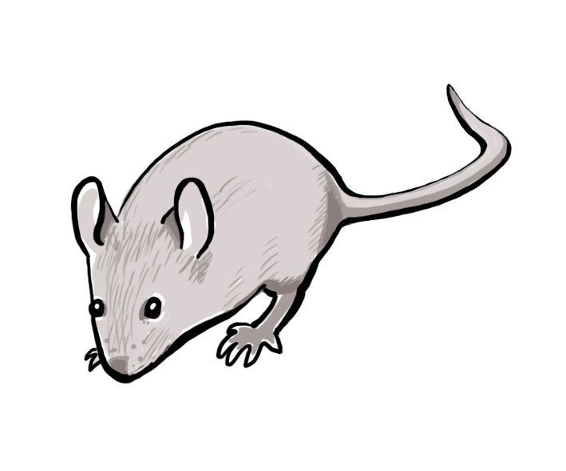
Goal 3a - Understanding and recognizing P&D
PAIN
Definition: Is an unpleasant sensory and emotional experience associated with actual or potential tissue damage that typically involves a noxious stimulus that activates nociceptors in the body’s tissues that convey signals to the central nervous system
Example: Animals are infected with a virus to induce a disease state. The use of analgesia has the potential to alter the pathogenesis and will confound the scientific results.
Animal Welfare
Stress
  Definition: is a real or perceived perturbation to an organism’s physiological homeostasis or psychological well-being—the body uses behavioral or physiological mechanisms to counter the perturbation.
  Example: Capture of wild animals to restrain for blood/tissue collection before release into their natural habitat.
Healthy animal= Healthy data point
Distress
  Definition: a state of distress develops over a relatively long period of time; however, short, intense stressor(s) can also compromise animal wellbeing and induce acute distress .
  Example: Prolonged restraint of an animal to induce a model of learned helplessness. Animals may exhibit signs of failure to cope at this point.
Eustress
Definition: is a state where an animal may not necessarily consider a stressor to be unpleasant, despite the observer’s subjective perception to the contrary.
Example: Running Wheel Experiment.
Notes:
Active Learning: Review each definition and then provide examples. Then have available a number of scenarios and have the student indicate which category it belongs to.

Slide 27
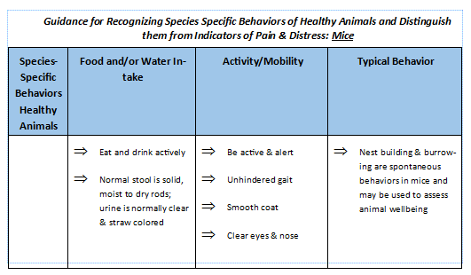
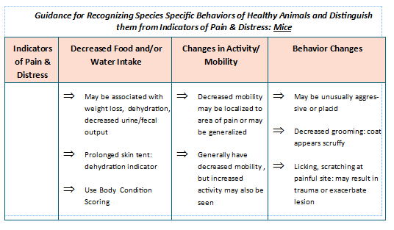
Goal 3a: Understanding and recognizing P&D
Objective: Recognize species specific behaviors
and distinguish them from P&D
Summative assessments: Review and report on pix, videos,
and models as various examples
Quick Guide Concept: There are 3 primary categories that can be used to assess animal health and well-being. They are: Food/Water Intake; Activity & Mobility and Behavior^{4,5}. The front side of the Quick Guide notes signs of health and the back side notes indicators of pain and distress.
Notes:
Quick Guide: Recognizing the challenges that both animal care and use staff face on a daily basis to identify species typical behavior and signs of pain and distress, a Quick Guide has been developed for staff to use while caring for or using live vertebrate animals. Similar Quick Guides can be developed for other species in the vivaria. This is a helpful training tool to have in each facility.

Slide 28
Goal 3a: Understanding and recognizing P&D
REFERENCES
1. Recognition and Alleviation of Pain in Laboratory Animals, NRC, 2009, pages: 2,3,4,13,14,15,18
2. Guide for the Care and Use of Laboratory Animals, NRC, 2011
3. Dr. Troy Hallman, Director, Yale University, Office of Animal Research Support (OARS)
4. Yale University IACUC, Clinical Signs of Pain and Disease in Laboratory Animals, July 8, 2015
5. Yale University IACUC, General Health-All Species, March 11, 2015

Slide 29
Goal 3b
Knowledge of how to manage P&D
Develop skills and apply appropriate methods to alleviate P&D. (HOC)
Use tools (e.g., scoring system) to assess pain level. (LOC/HOC)
Determine your role in the alleviation of P&D. (HOC)
Document an incident of P&D. (LOC/HOC)
Identify whom to report an incident of P&D. (HOC)

Slide 30
Goal 3b
Knowledge of how to manage P&D
Develop skills and apply appropriate methods to alleviate P&D
Skill for alleviation of Pain and Distress
Animal manipulations
  Animal restraint and handling
  Oral gavage
  IP, SQ, IM and IV tail injections

Slide 31
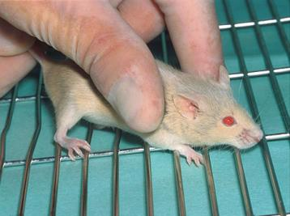
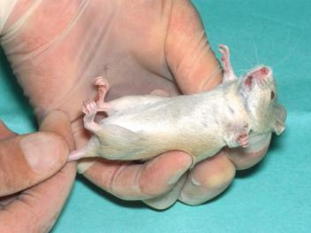
Goal 3b
Knowledge of how to manage P&D
Animal Handling and restraint
Notes:
The animal should be grasped by the tail, preferably the proximal third, and lifted clear of its cage. It should then be placed on a surface such as a cage top. If gentle traction is maintained on the tail, the animal will grip the cage top and attempt to pull away.
The scruff can be grasped between the thumb and forefinger whilst maintaining a grip on the tail. The animal is then secure and can be examined or injected safely.

Slide 32
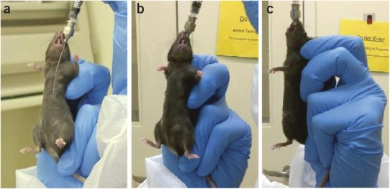
Goal 3b
Knowledge of how to manage P&D
Oral gavage
Notes:
The animal should be gently restrained (grasp the animal by the loose skin of the neck and back) to immobilize the head but not such that the animal vocalizes or shows other signs of distress. Maintain the animal in an upright (vertical) position and pass the gavage needle along the side of the mouth. Following the roof of the mouth, advance the needle into the esophagus and toward the stomach. If resistance is encountered you may be attempting to enter the trachea and you should alter your needle position.
After the needle is passed to the correct length, the compound may be injected. If the animal coughs, chokes or begins to struggle after compound administration begins, you may be injecting material into the lungs. If this occurs stop and withdraw the needle immediately. If it appears that material has been injected into the lungs the animal should be euthanized. Struggling during administration or excessive force in advancing the needle may lead to rupture of the esophagus or stomach. If you suspect this has occurred the animal should be euthanized.

Slide 33
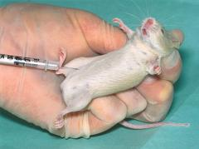
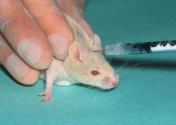
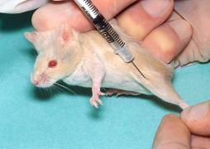
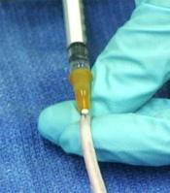
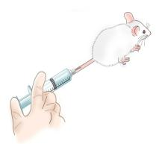
Goal 3b
Knowledge of how to manage P&D
IP, SQ, IM and IV tail injecctions
Notes:
Intraperitoneal injections can be made into the posterior quadrant of the abdomen.
Subcutaneous injection can be made into the scruff of the neck. Care must be taken to direct the needle into the scruff and not into the handler’s finger or thumb.
Because the muscle masses of mice are so small, care must be taken to use a small needle and a small volume for injection. Intramuscular injections can be made into the quadriceps muscle groups on the anterior of the thigh.
Before making an injection in a tail vein, it is helpful to induce peripheral vasodilation and make the vein more prominent for cannulation. You can raise the mouse’s body temperature with an incandescent lamp, by soaking the tail in warm water, or by administering vasodilating agents such as xylazine or acepromazine. You can also use a light source to transilluminate the tail which will make the vein easy to see and access. A safe water temperature is 110° Fahrenheit or 43° Celsius, which will gently warm the mouse. Although warming an anesthetized mouse is beneficial, be careful not to cause burns or overheat the animal.
The tail veins are located on each side of the tail, superficially just under the skin. When the needle is correctly placed in the vein, you may or may not see a flash of blood in the needle hub. You will sense that the needle has entered the vein because there will be less resistance to the advance of the needle inside the vein’s lumen than through the subcutaneous tissues. Likewise, upon injection, the fluid will flow easily into the vein, and the vein will become clear (changing from dark to light) as the fluid temporarily replaces the blood.

Slide 34
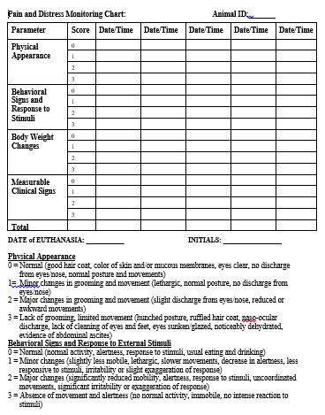
Goal 3b
Knowledge of how to manage P&D
Scoring system to assess pain level
Notes:
Provide handout to class. Discuss each category and signs seen in the animals.

Slide 35
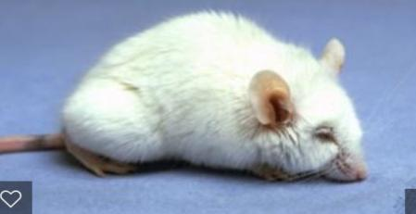
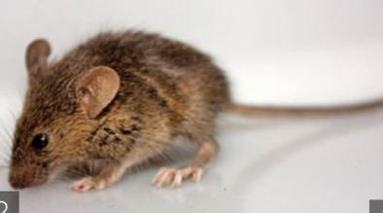
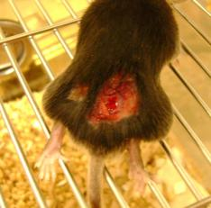
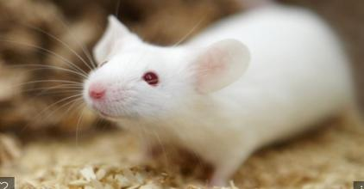
Assessment: How would you classify the mouse?

Slide 36
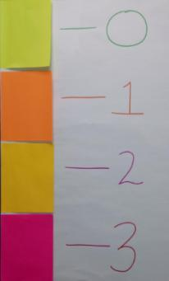
Assessment: Scoring system to assess pain level
Physical Appearance
0 = Normal (good hair coat, color of skin and/or mucous membranes, eyes clear, no discharge from eyes/nose, normal posture and movements)
1 = Minor changes in grooming and movement (lethargic, normal posture, no discharge from eyes/nose)
2 = Major changes in grooming and movement (slight discharge from eyes/nose, reduced or awkward movements)
3 = Lack of grooming, limited movement (hunched posture, ruffled hair coat, naso-ocular discharge, lack of cleaning of eyes and feet, eyes sunken/glazed, noticeably dehydrated, evidence of abdominal ascites)
Notes:
Students have 4 different color note pads to hold up. Each color represents a score on the physical appearance of the monitoring chart. The pictures of the mouse are shown and the students should be able to accurately identify the correct category.

Slide 37
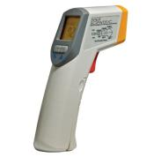
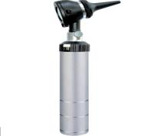
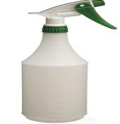
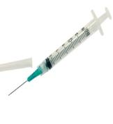
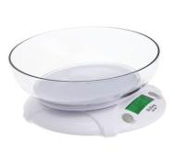
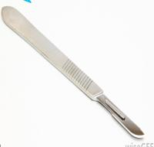
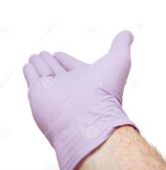
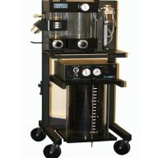
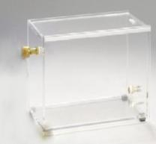
Tools Used to Assess Pain in Mice
Notes:
This exercise is to get the students to understand what items to use in the assessment of pain and distress. Show each of the items and have the students mark yes or no for their use. Explain how each item could be used and why other should not be used.

Slide 38
Tools Used to Assess Pain in Mice
TOOLS USED TO ASSESS PAIN
YES NO
Thermometer Gun
Otoscope
Spray Bottle
Syringe
Scale
Gloved Hand
Scalpel
Anesthesia Machine
CO2 Chamber

Slide 39
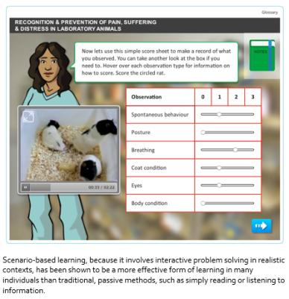
Goal 3b: Knowledge of how to manage P&D
Objective: Use tools (e.g., scoring system) to assess pain level
Formative assessment example
Courtesy of Prof. Paul Flecknell, recognized authority on P&D
https://flairelearning.com/course/recognition-and-prevention-of-pain-suffering-and-distress/

Slide 40
Goal 3b: Knowledge of how to manage P&D
Objective: Determine your role in the alleviation of P&D
Trained veterinary professionals should be involved in the design, monitoring, and documentation of experiments that have the potential to cause more than momentary pain and distress to laboratory animals.
Researchers must describe humane end-points in protocols where pain and distress are expected.
The humane end-points selected should be appropriate for the species and the experimental procedures.
The institution, through its IACUC, must ensure that all personnel involved in the care and use of animals are adequately trained. This includes proficiency in the following areas of expertise: procedures used for animal handling, experimental manipulations, and surgery; knowledge of the concepts and methods used to recognize pain and distress in laboratory animals; and, knowledge of how to immediately alleviate pain and distress, either directly or by soliciting the assistance of trained professionals.
Studies inducing pain and distress must be monitored by research staff, as well as by trained veterinary professionals, to ensure that protocol-specified treatments or other interventions are administered, and to assess whether humane end-points have been reached.
Notes:
The statements listed in this slide are taken from the American Association for Laboratory Animal Science (AALAS) position paper on “Alleviating Pain and Distress in Laboratory Animals.” In order to determine your role, you must first determine where you fit in the animal research protocol process. If you are the PI, it is your job to understand and adequately describe the pain and distress the animal is expected to experience. The institutional lab animal vet or one of the vet staff members should be able to assist with this process because they have been trained to know how this can be identified in each species. It’s the IACUC’s job to ensure that the information listed in your protocol will ensure the humane and ethical treatment of the animal including making sure the individuals listed on your protocol are adequately trained and can specifically recognize pain and distress in the lab animal and know how to alleviate it. Finally, the research staff as well as individuals listed on your protocol who are specifically identified to care for your animals need to closely monitor them to ensure that protocol specific treatments are provided or assess if humane end-points are reached.

Slide 41
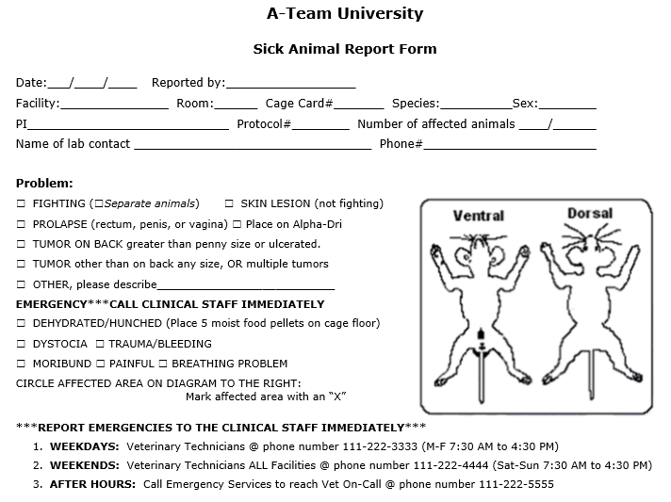
Goal 3b: Knowledge of how to manage P&D
Objective: Document an incident of P&D
Summative assessments: Complete a form with no omissions
Notes:
Scenario: Imagine you’re a Technician, Mr. Hannibal, at A-Team University. It’s after regular hours and you walk into your animal room which houses male mice. You look into one of the cages and one of the five mice has red and yellow spots all over its body. You pick up the mouse and upon further examination, notice that the mouse is very warm and feels much lighter than the other mice for his age and size. You immediately know something is not right. In our ICARE training we gave the condition the name ICARE Pox, using a mouse puppet with red and yellow stickers.
Action: At this point, please take about a minute or so to fill out this form based on the information provided to you in the scenario above. The identifying information (facility, room, cage card#, PI, protocol #, & name of lab contact) in the first section of the form can be made up. In the next slide you will see a completed form in order to check the accuracy of your completed form.

Slide 42
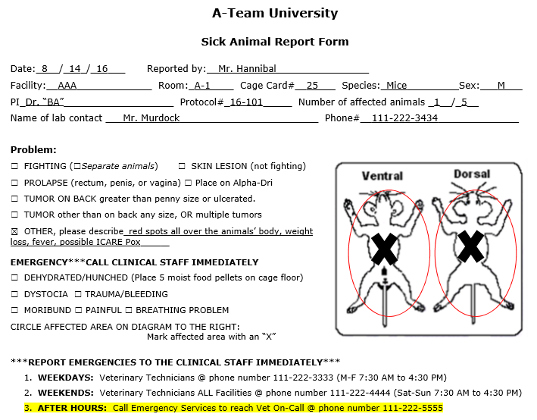

Goal 3b: Knowledge of how to manage P&D
Objective: Document an incident of P&D
Summative assessments: Complete a form with no omissions
Assessment with rubrics can be applied here:
0, pass
1-2, conditional
>3, re-train
Notes:
Here is a completed form with all the identifying information listed. Since the stated problems were not listed individually, we checked the other box and typed in the issues the mouse was experiencing. However, there is one mistake. Can you identify what it is? We also circled the affected areas of the mouse’s body based upon the information provided in the scenario. Finally, we highlighted who we should contact. It is important to note that the form should be filled out as completely and accurately as possible. This is requested so that if the form has to be left for the Veterinarian or the Vet Technician, he/she will have all the appropriate information needed to accurately diagnose the problem and treat the animal appropriately. You may also assess your animal care staff’s training by using the rubrics contained in the slide.
Mistake: Report says red spots. Scenario says the mouse has red and yellow spots.

Slide 43
Goal 3b: Knowledge of how to manage P&D
Director, Laboratory Animal Resources and University Lab Animal Veterinarian (ULAV) DVM, DACLAM
Business Coordinator
Clinical Veterinarian (P/T) DVM
Clinical Veterinarian (P/T) DVM
Veterinary Technician
Team Leader ALAT
Team Leader LAT
4- Animal Care Technicians
5- Student Workers
5 - Animal Care Technicians
6- Student Workers
Animal Facility Manager
RLATG, CMAR, ILAM
Objective: Identify whom to report an incident of P&D
Notes:
This is the organizational chart for the A-Team University. You can use this chart as a guide to identify whom to report an incident of pain and distress to. Names have been left out, but the degrees or certifications the person holds are included. As stated in the previous slide, we highlighted the fact that the Technician, Mr. Hannibal, would contact the veterinarian on call, specifically because it was after hours. As you can see from this chart, if you are a student, for example, working in the lab, you can report an incident to the animal care technician. The animal care technician can report to their team leaders or they can report to the facility manager, veterinary technician or clinical veterinarians. Of course, if the situation requires, the incident can always be reported the institutional lab animal veterinarian.

Slide 44
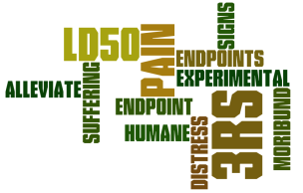
Goal 4a
Participants will understand and recognize humane endpoints (HE)
Define terms such as humane, endpoint, interventions, humane endpoints; compare to experimental endpoints. (LOC)
Recite (paraphrase) the three US government principles pertaining to HE. (LOC)
Describe what endpoint means and what it can be (how it manifests) in the context of animal research. (LOC/HOC)
Examine policies and guidelines about HE from various research institutions. (LOC/HOC)
Evaluate the role you can play in addressing HE. (LOC/HOC)
Example of
Wordle art
Notes:
Use technology like Wordle to become familiar with terminology.

Slide 45
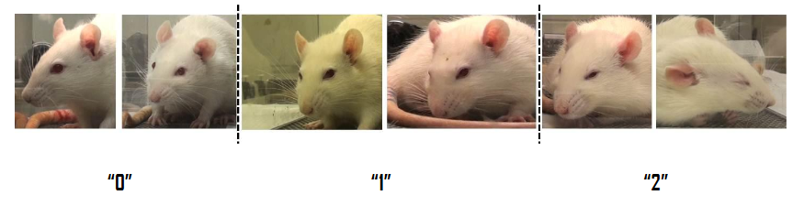
Goal 4b
Participants will learn to manage HE
Develop skills and tactics to identify and recognize HE from a study protocol. (LOC/HOC)
Develop skills and tactics relevant to managing HE. (HOC)
https://www.nc3rs.org.uk/sites/default/files/documents/Guidelines/RGS%20Manual.pdf

Slide 46


Goal 4b
Participants will learn to manage HE
Case study discussion item
Scenario: When I was a second year vet student, in a particular Virology lab exercise we had to inject mouse pups with a virus via the intracerebral route to learn about LD50s. After the lab, about half the class voiced some opposition to doing this and questioned its value and why couldn't alternatives be used. I brought this to the attention of the Director of LAR. Instead of addressing the issue with the instructor, he directed me to present the case to the IACUC. His presumption that this could be a good learning experience for a fledgling vet student like myself turned out to be correct. The IACUC advised the instructor to increase the learning component about the lab - to explain theory more thoroughly and include more frequent clinical observations. About two years later, the LD50 session of the Virology Lab was dropped from the curriculum.
To discuss: What are the humane endpoints? What are the ethical considerations? How are changes made and who can make them? What might have been the arguments for and against?

Slide 47
Pain and Distress and Humane Endpoints
RECAP!!!!
4 modules
When using animals in science and for the gain of knowledge, individuals must be aware to appreciate and consider the potential for pain and distress (P&D) in research investigations.
Individuals must appreciate various positions by experiencing several ethical considerations about P&D and HE.
3a Participants will understand and recognize P&D.
3b Participants will know how to manage P&D.
4a Participants will understand and recognize concepts of humane endpoints (HE).
4b Participants will learn to manage HE.

Slide 48
Acknowledgements and
Appreciation
Our ICARE facilitators and faculty
Professor Paul Flecknell
Dr. Norman Peterson
ILAR Guide
AWAR

Slide 49
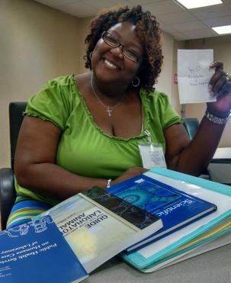
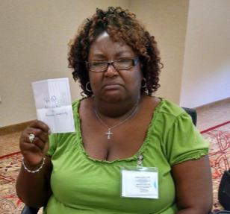
And, at the end of training…
Thank you for your attention
Learning about P&D
shouldn’t be so distressful

